Slide 1
Applied AI
Lecture 12
Dr Artie Basukoski

Slide 2
Agenda
Coursework
Review History, developments,
Issues and benefits
Future
UK Tech sector

Slide 3
Coursework
Due 18th Jan 2022, 1pm. (Last permissible date for assessments)
Individual work.
Domain means area of application. This must be different from FYP. Suggested areas :
Market analysis, algorithmic trading, personal portfolio management, Education, Games, Robotics, Hospitals and medicine, Human resources and computing, Transportation, Chatbots, News publishing and writing, Marketing, Music recognition and composition, Speech and text recognition, Data mining, E-mail and spam filtering, Gesture recognition, Voice recognition, Scheduling, Traffic control, Robot navigation, Obstacle avoidance, Object recognition.
If what you are interested in is not listed then write to me and we can add it.

Slide 4
Part A: Application area review
Choose one of the problem domains from below:
Market analysis, algorithmic trading, personal portfolio management, Education, Games, Robotics, Hospitals and medicine, Human resources and computing, Transportation, Chatbots, News publishing and writing, Marketing, Music recognition and composition, Speech and text recognition, Data mining, E-mail and spam filtering, Gesture recognition, Voice recognition, Scheduling, Traffic control, Robot navigation, Obstacle avoidance, Object recognition.
Different from domain in FYP.
Brief literature review
How has AI been applied to this problem domain.
How is the task modeled? (using search, logic, ml etc)
Look at the notebook(ipynb) files in the aima-python directory for examples.
You can write everything inside the notebook file.
If you want to, you can go over in terms of length, but try to stay focused and within 20% of the word length.

Slide 5
Compare and evaluate AI techniques
During the literature review you should have identified three different AI techniques to apply to your domain.
These can vary from algorithms (A*, DFS,BFS) through to the application of different techniques, NN, Clustering, etc, or combination of both.
Note that difficulty and depth will be a factor in your final mark.
Think about
What real world problems does the system try to solve?
What are the inputs outputs?
What are the pros and cons of different techniques.
Please don’t try to come up with a new approach.
(contact me if you want to do a PhD)

Slide 6
Implementation/exploration
This is not like your final year project but more like the notebook files. You only need to provide an example showing the application of the techniques to a new domain and data. Show all references.
B. Draw a high-level diagram describing how all the elements of your project work together to achieve the desired result. [5] (examples on next slide)
A. Describe the input required for your implementation/exploration of your chosen techniques. [10]
C. Implement a prototype. The prototype should provide a sufficiently detailed example suitable for evaluation of the results. The implementation must be done as a Jupiter notebook. [40]
Again, difficulty will be a factor in your overall mark.

Slide 7
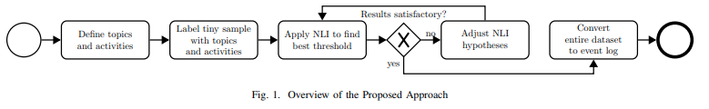
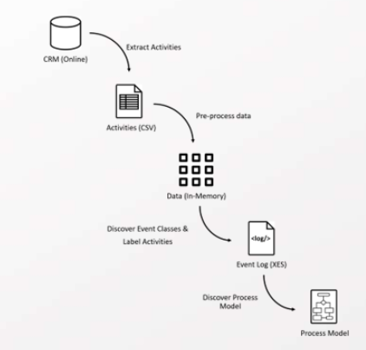
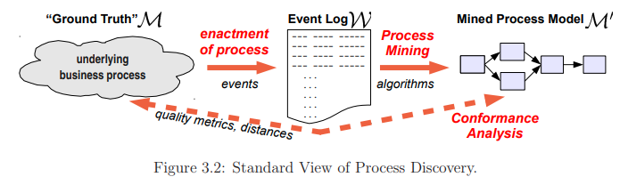
Coursework: High level diagram examples

Slide 8
Testing (Part D)
Part D, test the software correctness.
Compare expected/correct results with those produced by your implementation
How did it perform on different sizes of input? (Time/space complexity)
Was there any unexpected behaviour and how did you deal with it. For example, loop in the graph, time issues due to exponential performance.
Document any errors and how you would go about solving them if you had more time.

Slide 9
Evaluation (Part E)
Part E, run experiments with your prototype and interpret results.
How do you interpret your output. How useful are your results. Do you have an evaluation metric for success. Eg, shortest path, percentage classified correctly, etc.
What are the pros and cons of your technique/s. Are there cases that it cannot deal with?
What is the Time space Complexity? Does the result
Were there any surprises?
Again, if you want to, you can exceed the word limit.

Slide 10
Revisit the question, What is AI?
A branch of computer science dealing with the simulation of intelligent behavior in computers.
The capability of a machine to imitate intelligent human behavior.
Strong AI: Systems that think like humans (general intelligence)
Weak AI: Just get systems to work without figuring out how human reasoning works (specific intelligence)
Use human reasoning as a model but not necessarily the end goal
“A computer program is said to learn from experience E with respect to some class of tasks T and performance measure P, if its performance at tasks in T, as measured by P, improves with experience E.”

Slide 11
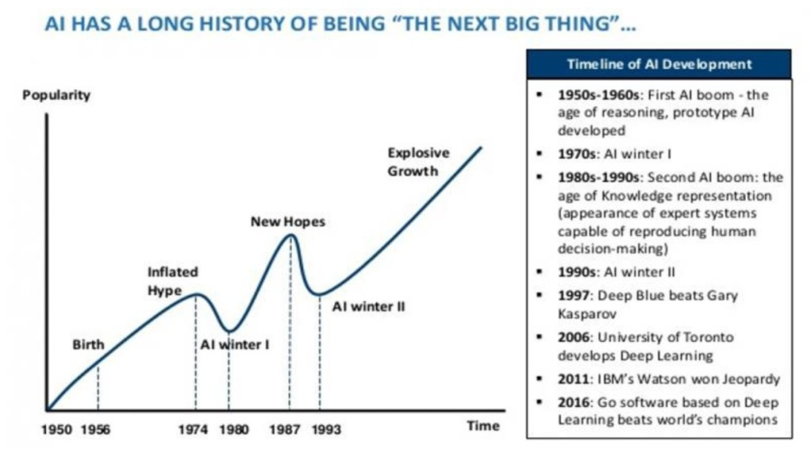
AI Promises

Slide 12

The Ligthill report
Paper: "Artificial Intelligence: A General Survey" by James Lighthill, published in Artificial Intelligence: a paper symposium in 1973
Formed the basis for the decision by the British government to end support for AI research in most British universities.
Critical of basic research in foundational areas such as robotics and language processing. Success comes from control theory, mathematics, algorithms.
AI failed at addressing combinatorial explosion when scaling up to solving “real-world” problems. (exponential complexity problem)
Are any of the statements still relevant today?

Slide 13
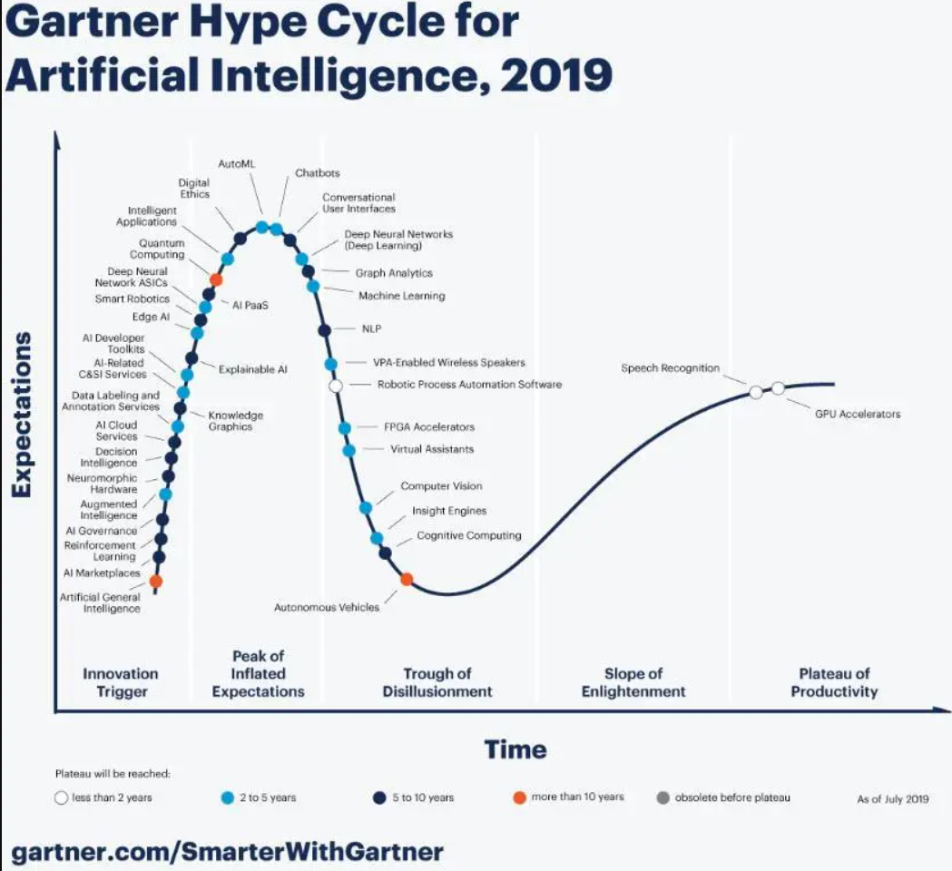
Golden Age or another AI Winter?
Still have hype but something is different (non toy-domain results)
Some of the success can be attributed to advancement of computational capability and availability of ‘big data’
AI is always the next big thing, hence never attainable. Should we call it Computational Intelligence to tone down the hype?
Money and marketing vs Scientific reality. Gartner predicts 16Trillion industry by 2030!

Slide 14

Issues and concerns with AI
Ethical/Legal implications – if AI is mainstream who is responsible?
Inherent bias in data? AI favours men for jobs due to historic training data
Tracking you and targeted advertising. Products can help but also target vulnerabilities.
Displacing employees. Taxi drivers -> Self driving cars.
Can AI achieve Consciousness? Is General AI even possible? Mind transfer? What happens if/when we reach the singularity – many have weighed in on this topic including – Hawkings, Musk, Kurzweil etc
Can you think of others?

Slide 15
Case study – Google Project Maven
2018 Google collaboration with Department of Defense on project Maven made many employees quit.
Project Maven, uses AI to analyse drone footage to detect people and objects.
Thousands signed petition wanting Google ("Dont be evil") to do the right thing.
"Wrong to build technologies for military surveillance with potentially lethal outcomes"
-> Google said it will not continue Project Maven.
-> Also published AI principles to outline where the company stands on ethical AI
BUT
Only general and vague claims.
They will not work on technologies to "directly facilitiate injury to people". However, they also stated that they will continue to work with the military and government in other areas including search and rescue.
What do you think?
See TEDx talk: https://www.youtube.com/watch?v=cplucNW70II

Slide 16
Case study - Discussion
Does this rule out googles work on Project Maven? Same technology can be used for both targeting and Search Rescue.
Vague to the point of being meaningless. For example, for accountability and safety they state.
Design AI systems to be appropriately cautious.
Test and monitor in appropriate cases.
Subject them to appropriate human control.
What does "appropriate" mean?
But should the military overrule all surveillance even if the goal is to save lives? Positions must be clear on both sides.
ETHICS Washing - giving the appearance of doing ethics. Regulation and compliance to avoid Ethics policing.
Other examples: Algorithms create Filter bubbles, reinforce discrimination by excluding women from high-powered jobs, excluding certain minorities as high risk.
For you FYP did you give serious consideration to the ethical impact of your project? How your product abstracts decision making, harm users, or make some groups worse off.
How to deal with these questions.

Slide 17

Advantages and benefits of AI
Higher intelligence brings greater insight and understanding. Did AlphaGo destroy the game of Go?
AI/Robots can do jobs that humans cannot. Greater efficiency 24x7, productivity and hence quality of life.
Copy/paste knowledge. Transfer of skills – humans need years.
Aid human engineering and creativity. Bicycles for the mind.
Autonomous wars – no/less humans involved?

Slide 18
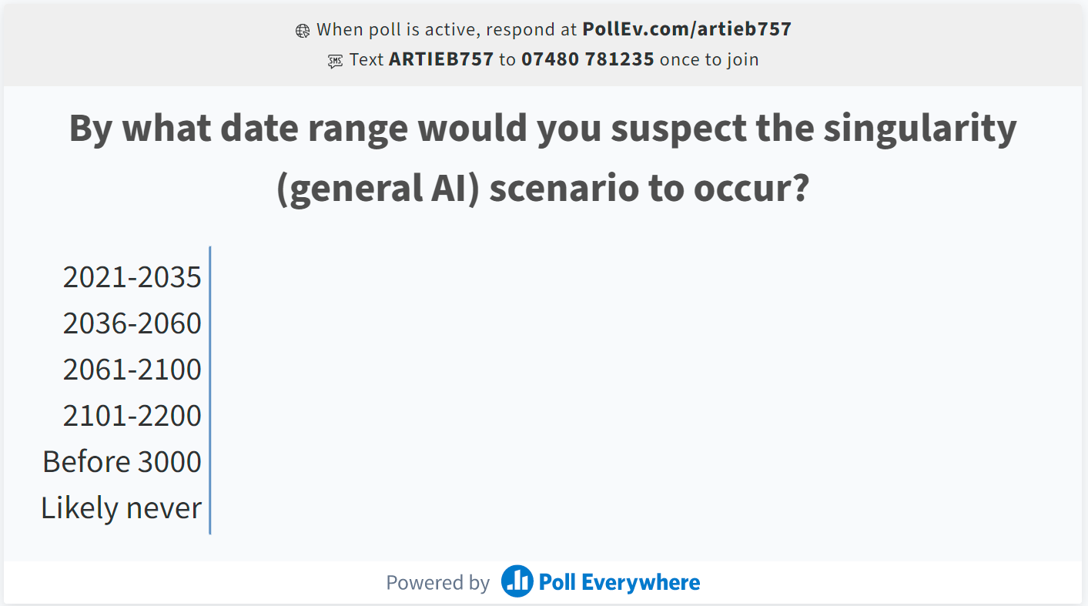
Polleverywhere

Slide 19
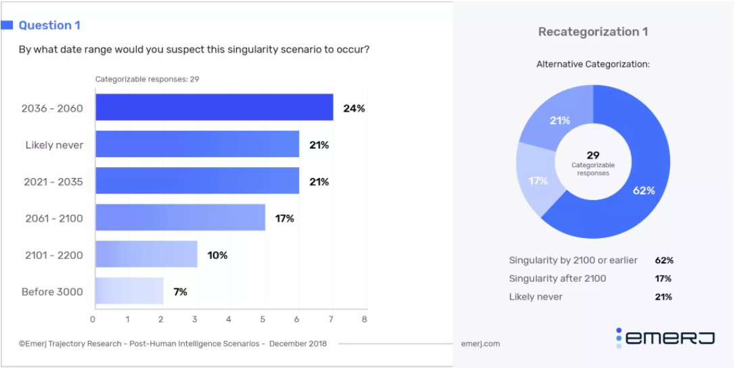
Predictions for General AI, Singularity
https://emerj.com/ai-future-outlook/when-will-we-reach-the-singularity-a-timeline-consensus-from-ai-researchers/

Slide 20
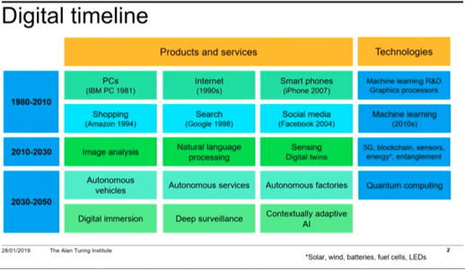
AI Future
Turing Lecture: Glimpsing our AI future
https://www.turing.ac.uk/events/turing-lecture-glimpsing-our-ai-future
Howard Covington
“AI meets the real world”

Slide 21
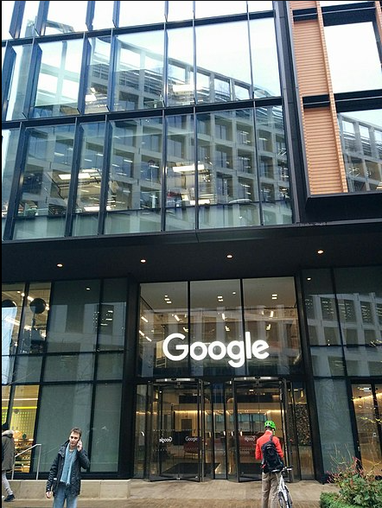
UK Tech sector
Value of UK tech industry between £250 - £580 billion
Fourth in the world for venture capital investment.
Success stories: Ocado, Deliveroo, Monzo, Revolut
Recent Employability Advisory Board meeting takeaway:
Specialist skills in high demand. AI is on the forefront.
Companies hiring more. One company had 37 vacancies.
Sector continues to grow, reasons to be optimistic!
I look forward to inviting you to present your discoveries in future lectures as alumni.

Slide 22
Questions Discussion?

Slide 23
